Slide 1
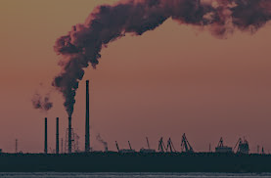
`1qw
Pollution remover

Slide 2
`1qw
The content of factories harmful gases
carbon monoxide
lead
nitrogen dioxide
ozone
Particles
sulfur dioxide
The pressure needed will be calculated by Henry’s law

Slide 3
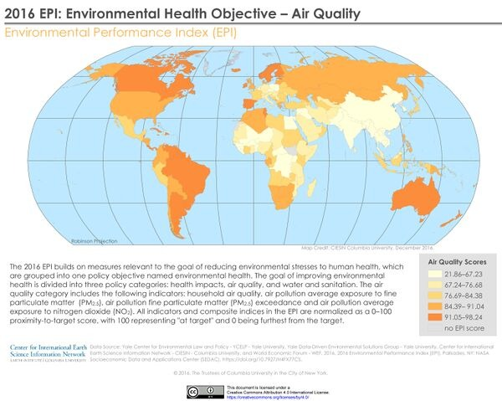
`1qw
This photo shows the quality of air on earth
As shown there is many places that have high percent of pollution and this affects on people health
So that we made our project

Slide 4
`1qw
Details of the project
The idea of the project is to eliminate the smoke from factories which is a threat to the life of the planet. By compressing and dissolving it in water. And then we're going to filter the water and get rid of that harmful gases. The material used in initiation is something that compresses the harmful gases. We used the stainless-steel because it is the least reactant and will not be significantly affected in the long term either. Pipes for connection and valves for water entry or exit control. The advantage of the project is that we've completely decontaminated without adversely affecting anything else. Also, the project isn't complicated to make because the materials we used are available everywhere with low cost. We hope to save our planet from the risks that it faces, such as global warming, ozone drilling, the sinking of coastal cities, and the extinction of animals from changes in the atmosphere, all caused by pollutants from factories mainly. We also hope that, even with a little bit of thought, we're going to eliminate this pollution.

Slide 5
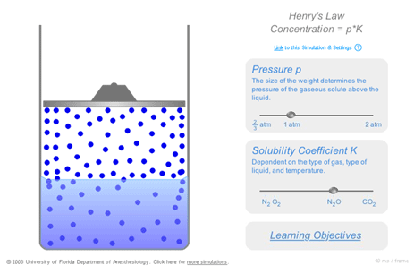
`1qw
The idea of stands on making pressure on the smoke and the water
When we make pressure on smoke and water the harmful gases will dissolve in water

Slide 6
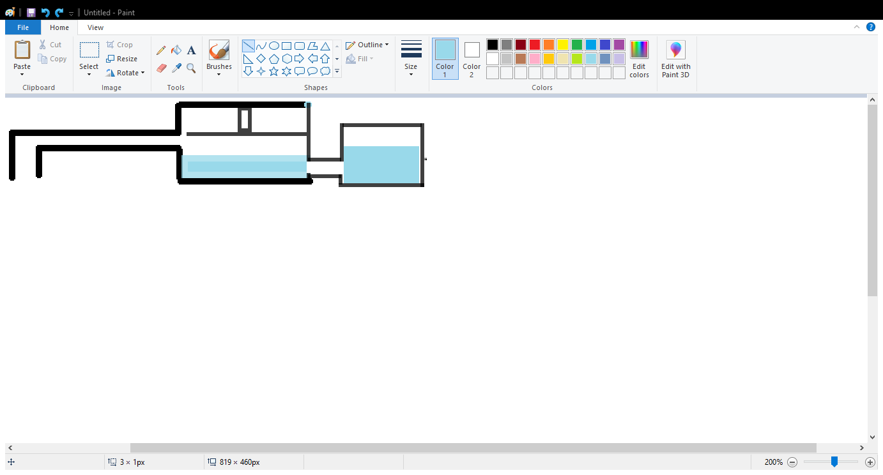
`1qw
First, the harmful gases will enter the device .
Then, the compressor makes pressure on the harmful gases and water
Compressor
Polluted water
smoke
smoke

Slide 7
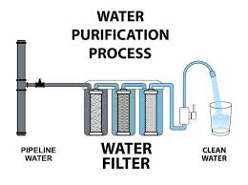
`1qw
Finally, we filter the dirty water

